Slide 1

How to use the gtor github
Andrew Hellrigel – fall 2021

Slide 2


What is git/Github?
Git is software for tracking changes in a set of files
Allows for cloud storage of files and for improved workflows between team members working on the same project
GitHub is the online interface for git

Slide 3
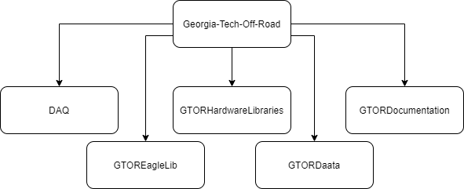
Gtor github
GTOR GitHub is broken up into 5 main repositories: https://github.com/Georgia-Tech-Off-Road

Slide 4
DAQ
DAQ is the “main” repository
Contains PCB designs for all projects
Main projects (dashboard, aux daq) get top level folder
Others get subfolder in Misc_Projects
Contains project specific software
Ex. Dashboard control software
Contains MATLAB scripts for data post processing

Slide 5
GTOR eagle lib
GTOREagleLib is the repository for EAGLE component libraries
5 main libraries
Active components
Passive components
Breakout Boards
Microcontroller
Connectors
See 03 – Electrical Documentation/Eagle_Libraries_Guide.docx

Slide 6
GTOR Hardware Libraries
GTORHardwareLibraries is the repository for embedded C++ libraries
3 main folders **Still in progress
CommsUtility
Sensor
Other
See 04 – Software Documentation/Hardware_Libraries_Guide.docx

Slide 7
GTOR Daata
GTORDaata is the repository for the DAATA python application (Data Acquisition and telemetry application)
See 04 – Software Documentation/DAATA Documentation.docx
See 04 – Software Documentation/Python Software Documentation

Slide 8
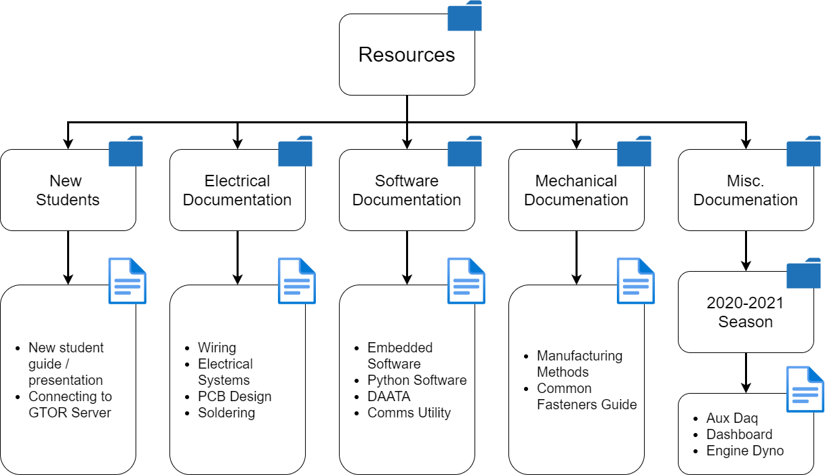
GTOR Documentation
GTORDocumentation is the repository for all documentation
Documentation

Slide 9
Installation
Install git, the underlying version control software https://git-scm.com/downloads
Install a user interface for git (or use git bash or command prompt if you prefer)
https://education.github.com/pack
https://www.gitkraken.com/download

Slide 10

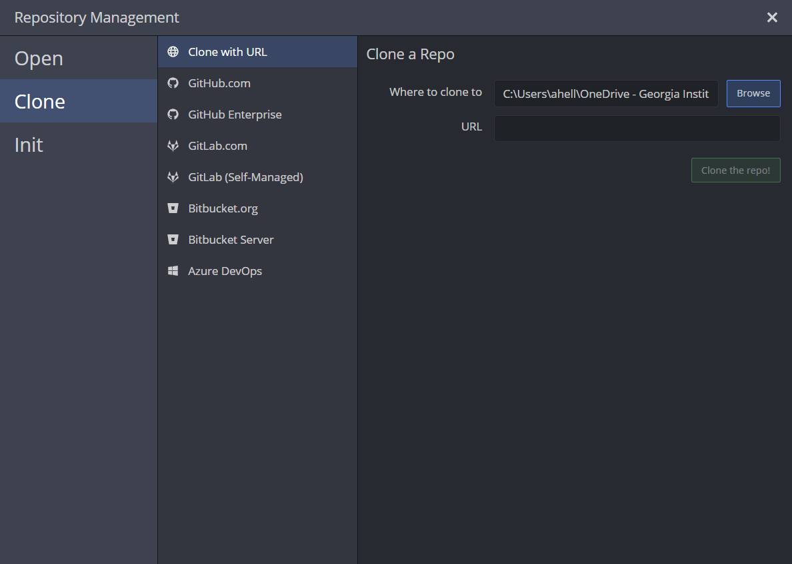
Clone a repository
Add a new tab in gitkracken
Choose a folder to clone into (I usually do Documents folder)
Use the URL of the repository

Slide 11
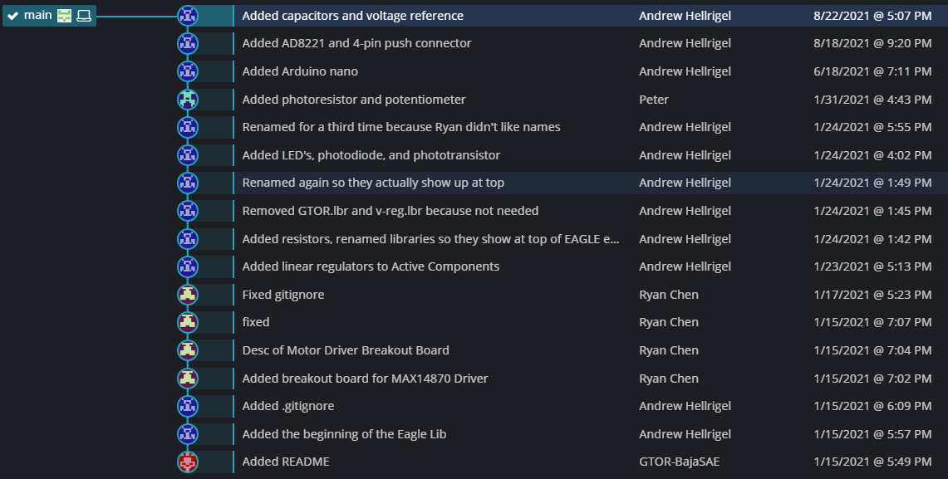
commits
Commits are like a “snapshot” of everything in the repository at a point in time

Slide 12
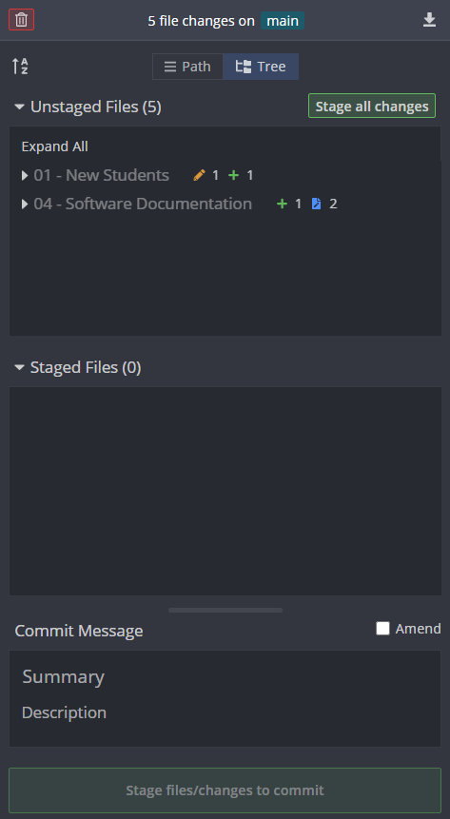
Make commits
Stage all changes
Write a commit message
(Usually starts with a verb)
Commit changes

Slide 13

PUSH/pull
“Pull” takes changes from origin (changes that other people have pushed) and updates your local repository to them
“Push” takes changes from your local repository (anything that you’ve committed) and updates the origin repository (what you see on github.com)

Slide 14
Branches
Branches

Slide 15
Become a contributor
Make an account on github.com
Send your username in the #git channel on the discord
One of the leads will add you as a contributor (Otherwise you can’t push)

